Slide 1
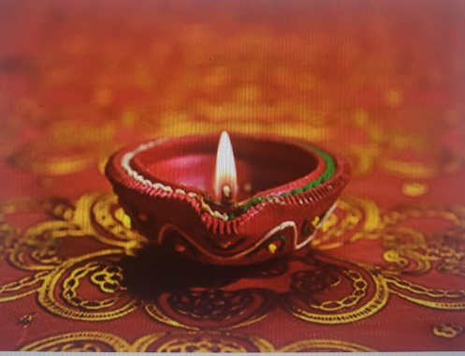
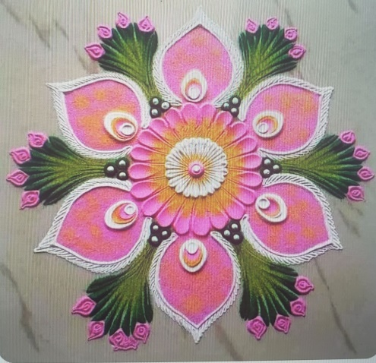
Deepawali
Commonly known as Festival of Lights
Deepawali is a Sanskrit words and it means rows of Diya or light
It is a five day festival, celebrated annually by Hindus, Sikhs, Buddists, Jains, etc.
This year, it will be celebrated on November 4, based on the Lunar calendar
Celebration involves cleaning house, making Rangoli, lighting Diyas, offering prayers, exchange well wishes and sweets
Goddess Laxmi bestows wealth and prosperity

Slide 2
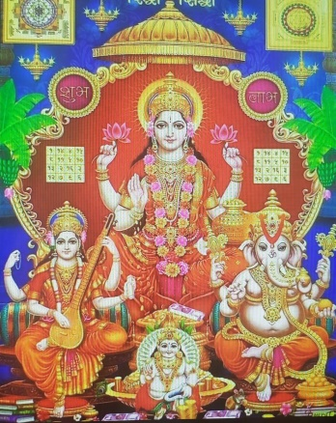
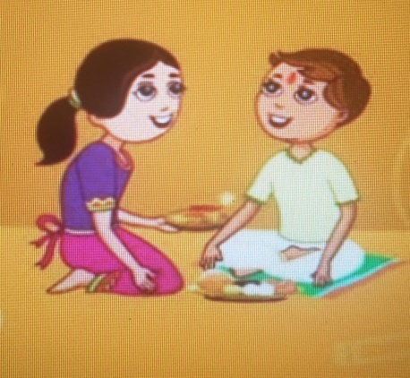
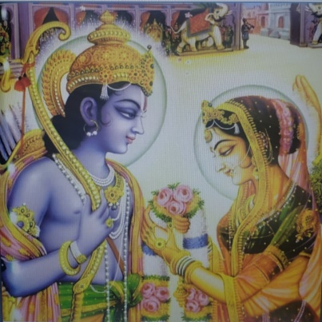
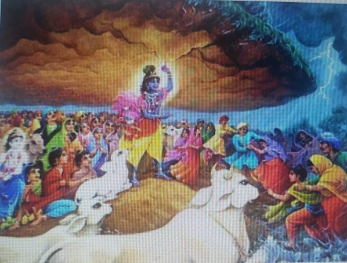
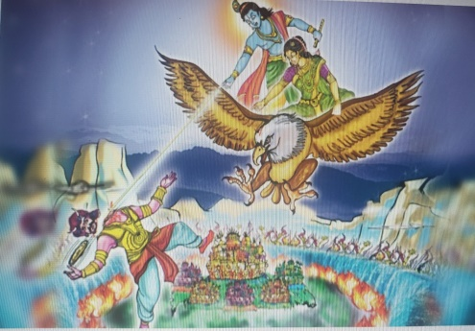
The Five Days of Deepawali
Dhanteras: Goddess Laxmi bestows wealth and prosperity
Chotti Deepawali: Triumph of good over evil. Mother places society welfare over her own personal joy
Deepawali:- Lord Rama came home after defeating the ten headed demon Ravana. Start of Hindu New Year.
Govardhan Pooja: Lord Krishna lifted a mountain on his pinky finger to protect people from torrential rains
Bhai Dooj: Brother and sister strengthen the bond of love and affection by tying sacred thread to each other.

Slide 3
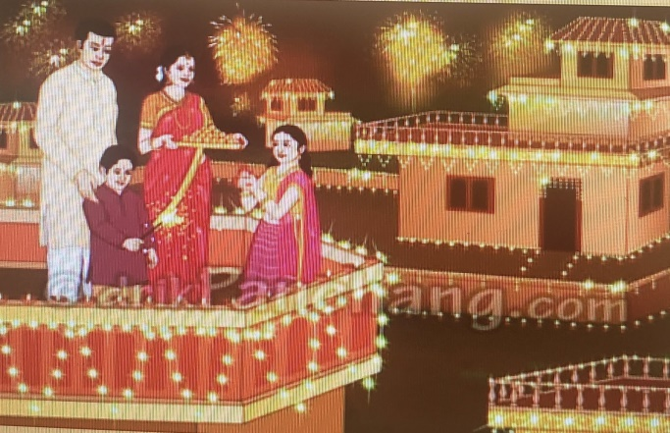
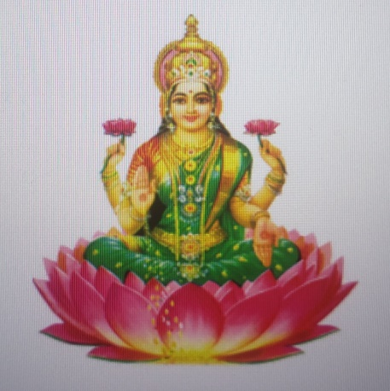
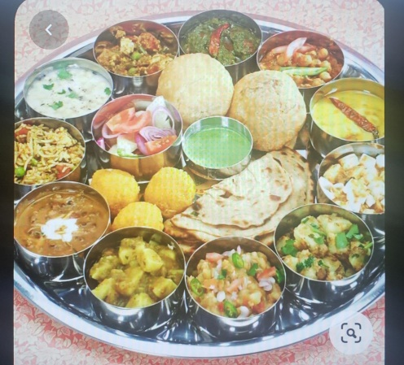
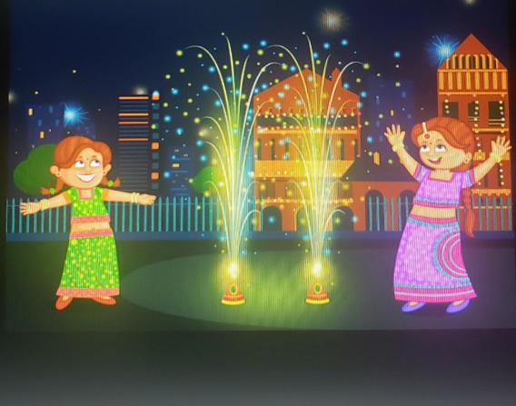
Significance of Deepawali
Marks the beginning of Hindu New Year
Symbolizes victory of Good over Evil
It brings together families, friends, and communities
People renew their commitment to uphold values of truth, non-harming, and restraint through their thoughts, words, and actions
It is time for Daan (charitable giving) and Sewa (selfless service)
People light lamps to remember that light triumphs over dark, knowledge prevails over ignorance, and good triumphs over evil.

Slide 4
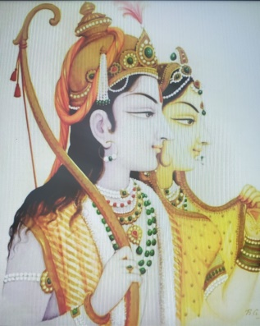
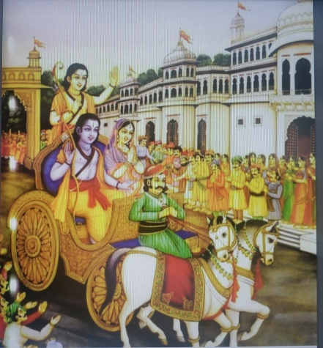
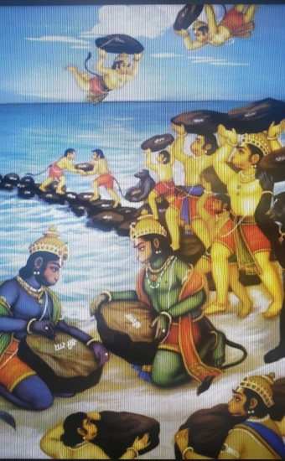
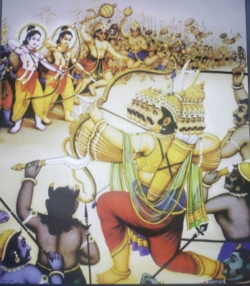
Lord Rama story
Ram was all set to be coronated as the King of Ayodhya
His step mother, sends him on exile for fourteen years and gives the thorn to her son
Ram leaves for forest with his wife Sita and brother Laxman
He fights many demons, restores justice, makes new friends
A demon Ravana abducts Sita and takes her to Lanka
Rama‘s army builds a bridge between India and Lanka
Rama defeats Ravana
Rama and Sita return to Ayodhya after fourteen years.
People light Diyas all over the city and welcome Rama
Rama becomes King and everyone lives happily under his rule.

